Slide 1

DAYC-2 Training and Report Writing
Accurate Assessment Leads to TARGETED IEP Goals

Slide 2
DAYC-2
What is it and why is this important to my student's growth and development?

Slide 3

DEvelopmental Assessment of Young Children
The DAYC-2 is a comprehensive tool for infants and young children. The 2nd Edition was published in October 2012. Developed by Judith K. Voress, PhD and Taddy Maddox, PhD

Slide 4
Five Developmental Domains
Allows for assessment of the five domains of development mandated for assessment and intervention by IDEA
Cognitive
Social-Emotional
Adaptive Behavior
Communication
Receptive language
Expressive language
Physical Development
Gross motor
Fine motor

Slide 5

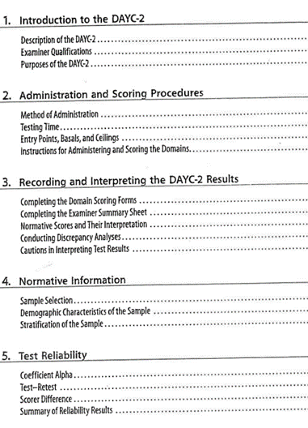
OVERVIEW of DAYC-2
Understanding the DAYC-2
Administering the DAYC-2
Scoring the DAYC-2

Slide 6

Important Reference Charts for Scoring
Appendix A: Converting Raw Scores to Age Equivalents pg. 59
Appendix B: Converting Raw Scores to Standard Scores pg. 63
Appendix C: Converting Standard Scores to Percentile Ranks pg. 117
Appendix D: Converting Sums of Subdomain Standard Scores to Domain Stand Scores pg. 121
Appendix E: Converting Sums of Domain Standard Scores to General Development Index pg. 125

Slide 7

TEsting Administration
Ages: Birth through 5 years 11 months
Testing time: 10 to 20 minutes for each domain
You may administer the whole test during one sitting. This will depend on the child's attention span. You can decide the testing order of the domains. Each domain is assessed individually and a separate scores is reported for each domain.

Slide 8

Best Practice for early childhood providers is that all five domains are assessed, as delays in one area of development may have impacted development in another area of development. It is always better to assess and determine there is no delay than to assume the child has no delays in a specific domain that was not the primary area of concern.

Slide 9
Options for Assessment
The format allows multiple ways for examiners to obtain information during the assessment including:
Direct assessment (“Can you tell me your name?)
Observation of the child in the natural environment and Interview of parents, caregivers and teachers

Slide 10
As there are no specific requirements for any items to be completed by direct assessment, if a child does not get credit on an item during direct assessment, credit can be given at a later time in the assessment process if the child is observed demonstrating the skill during another activity.
For example: If the child does not stack 8 blocks on request for the examiner, but is later observed to stack 10 blocks in the play center or the teacher reports that the child is consistently able to stack 8 to 10 blocks as part of the preschool activities; then the examiner should go back and give credit for the test item.

Slide 11
Test individuals, not groups of children
Establish comfort level prior to test. Practice giving & scoring items.
Test in environment free of distractions (ventilation, lighting, quiet, private, comfortable)
Establish rapport with child & parent/caregiver
Stop testing if child fatigued or loses interest
Praise & encourage child without evaluating accuracy. Say: " You did that quickly" or "You seemed to like that" instead of "Very good" or "That's right."

Slide 12

Early Childhood Developmental Chart
Refer to the Development Chart prior to testing to review the typical developmental milestones in early childhood. Knowing what is “normal” will help you to confirm that a disability may/may not be present.

Slide 13

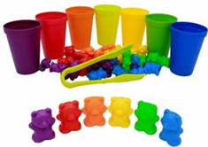
Gathering TESTING ITEMS
Make sure have access to all the materials you will need for the assessment prior to beginning the test.
Familiar items from the child’s natural environment can also be used such as toys, a favorite cup, or special crayons.

Slide 14
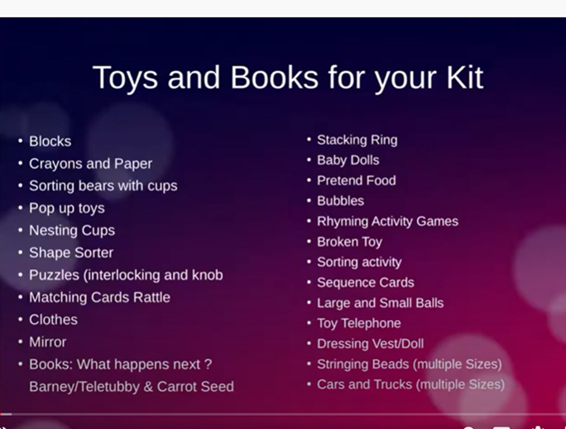
Gathering TESTING ITEMS
Being organized is a key to a successful test administration.

Slide 15
HELPFUL tips
Look for opportunities for the child to demonstrate specific skills in play and during observations.
Add some observations into your report to help the CPSE committee more fully see the ability level of the child.
Remember to not lead / prompt the child to the answer as this can providing inaccurate results.

Slide 16

Figuring out Chronological AGE
You need to know the chronological age of the child. Once you have the years and the months, ignore the remaining days, do not round up to the next month if the days are over 15 days. Do not adjust age for prematurity.
Example found on Page 30 in Examiner's Manual:
Figuring out the chronological age digitally: https://pearsonagecalculator.com/

Slide 17
Figuring out Chronological AGE
Example on Page 13 on DAYC-2 Manual:
Year Month Day
Date of Testing | 2011 | 9 | 18
Date of Birth | 2009 | 3 | 13
Age | 2 | 6 | 5
Age in Months |  | 30

Slide 18
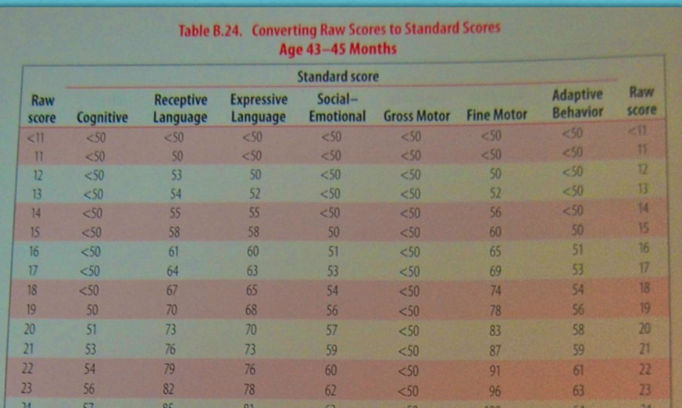

Figuring out Chronological AGE
This number is essential for scoring. Make sure you are on the right chart (look for the range of months on the top) and look for the column depending on what you are testing.

Slide 19
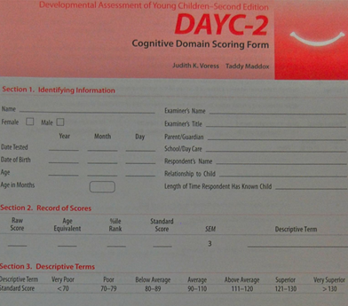
Cognitive Domain
This domain measures conceptual skills: memory, decision making and discrimination.
Most of these items are appropriate to administer using observation and direct assessment.
This domain requires the use of toys and materials.
It may be helpful to spend some time in free play and developing a rapport with the child, prior to using direct assessment for these items

Slide 20
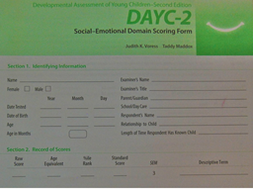
SOCIAL-EMOTIONAL DOMAIN
This domain measures social awareness, social relationships and social competence. This skills enable children to engage in meaningful social interactions with parents, caregivers, peers and others in their environment.
Sample questions include: • Smiles at or pats own image in the mirror (#13) • Imitates facial expressions, actions, and sounds (#19) • Sings familiar songs with adult (#30) • Avoids common dangers (e.g. sharp knives, fire, hot stove) (#36)
It is important to note behaviors shared with parent and/or teacher regarding observed behaviors such as tantrums and excessive crying.

Slide 21
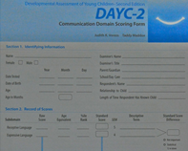
COmmunication domain
This domain measures skills related to sharing ideas, information and feelings with others, both verbally and non-verbally.
This domain uses objects and pictures as part of the administration.
Many pictures and objects can be used for a variety of questions. For example, the same pictures used for identification can also be used for “wh” questions
This domain has two sub-domains: Receptive and Expressive Language.

Slide 22
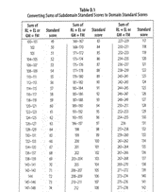


COmmunication domain
Receptive Language (RL) and Expressive Language (EL)
Initial scores will be calculated in the subdomains of Receptive Language and Expressive Language. These are then calculated into a Total Communication Score using the chart in Appendix D of the Examiner’s Manual on page 121. •
Combine the sub-domains and the total score will give you a standard score. Sub-domains are on Motor Domain as well.

Slide 23
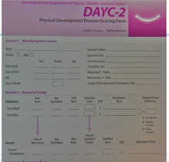
MOtor Development domain
This domain measures motor development. This domain has two subdomains: Gross and Fine Motor.
A ball, access to playground equipment, and access to stairs is helpful in completing this part of the assessment.
Initial scores will be calculated in the subdomains of Gross Motor and Fine Motor. These are then calculated into a Total Physical Development Score using the chart in Appendix D of the Examiner’s Manual on page 121.

Slide 24

Motor Development Domain
Gross Motor (GM) and Fine Motor (FM)
Initial scores will be calculated in the subdomains of Gross Motor and Fine Motor. These are then calculated into a Total Communication Score using the chart in Appendix D of the Examiner’s Manual on page 121.
Combine the sub-domains and the total score will give you a standard score.

Slide 25
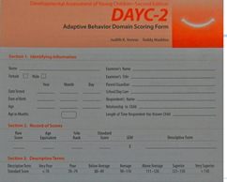
Adaptive Domain
This domain measures independent, self-help functioning. Skills include toileting, feeding, dressing and taking personal responsibility.
Sample questions: • Purposely pulls off own socks (#14) • Drinks from open cup or glass held by adult – not a sippy cup (#19) • Opens door by using handle or knob (#25) • Sits on toilet for at least 1 minute supervised (#29)
Parents and Classroom teachers are very helpful with this information.

Slide 26
Administering
Finding out where the child is developmentally

Slide 27

Did the Child Master the Skill?
Passed = Mastered Skill = 1 point
Not Passed = Skill Not Mastered = 0 point

Slide 28

Mastered vs. Not MASTERED
There is no credit given for emerging skills – if skills are still emerging but not mastered, the item should be marked as “0” and a notation made that the child has emerging skills or partial skills in this area. The goal is to determine if an ability is sufficiently mastered so that continued instruction on this skill level is not necessary.
If a child can ONLY do a skill with one person, in one location and with one set of materials, consider not marking the skill as mastered. If a child has not had the opportunity to develop a skill (i.e.- has never had the opportunity to use scissors or drink from an open top cup), then the child cannot demonstrate the skill and a “0” is awarded

Slide 29

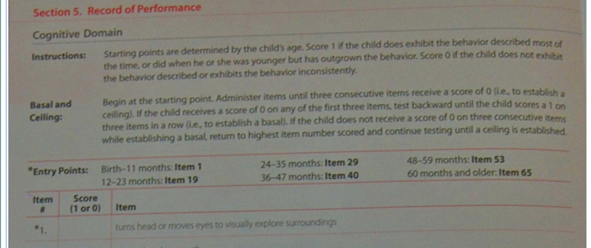

Starting Point – where do you start the assessment?
The entry point for each domain is determined by the child’s chronological age and will be different from domain to domain.
Entry points are shown at the top of each scoring form. Locate the child’s age in months within the listed starting points and begin with that item.

Slide 30

Entry POINTS
Entry points, basals and ceilings are used to shorten testing time. For each domain administration should begin at the appropriate entry point.
The entry point for each domain is determined by the child's chronological age and will vary from domain to domain. This is listed at the top of the testing materials and a full listing on Pg 7 in the test manual.

Slide 31
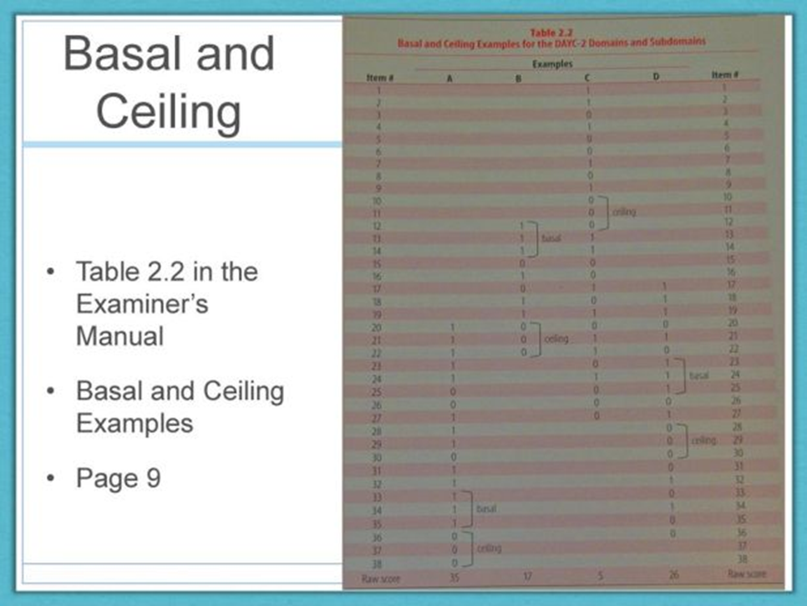
Finding the Basal and the Ceiling
You will need to find the Basal and Ceiling in order to calculate the Raw Scores. The Raw Scores are transferred to the front of the scoring form at the end of the assessment of each domain.
Begin administering the assessment at the designated starting point. If the child receives a “0” for any of the first 3 items administered – the examiner should then test backward until the child scores a 1 on three items in a row.
The BASAL is established when the child receives a score of 1 on three items in a row.
All questions “below” the BASAL (the questions that come BEFORE the three 1’s on the form – are each scored as a 1, even if the child would have scored a 0 if the items was administered.

Slide 32

Finding the Basal and the Ceiling
CEILING: Where a child is no longer able to perform skills with mastery within a certain age range – demonstrated by three 0’s in row.
This is the stopping point.
Occasionally, you will have some items “above” or past the ceiling (past the three 0’s) that the child would have received a 1 on if the item has been administered. Or the child may have already received a 1 on the item past the ceiling if the evaluator has administered the items. These items are STILL counted as 0’s if they are past the ceiling.
There can be several basals and ceilings. Always pick the basal and the ceiling that are closest together when computing the raw score.

Slide 33
SCORING
Interpreting DAYC-2 results accurately

Slide 34
Important Reference Charts for Scoring
Appendix A: Converting Raw Scores to Age Equivalents pg. 59
Appendix B: Converting Raw Scores to Standard Scores pg. 63
Appendix C: Converting Standard Scores to Percentile Ranks pg. 117
Appendix D: Converting Sums of Subdomain Standard Scores to Domain Stand Scores pg. 121
Appendix E: Converting Sums of Domain Standard Scores to General Development Index pg. 125

Slide 35
Calculating Raw Score – Do an example – Practice Makes this much easier!
Step 1: When calculating raw score points, use the item # at the end of the basal (the third item that was given 1 point) as your starting score, even if there are 0’s recorded in items before the basal. (So if your 3rd “1” was on item # 28 – then you start counting at 28 as ALL items prior to that now get a score of 1)
Step 2: Once you are past the basal, only the 1’s are counted until you get to the ceiling (the first three 0’s after the basal). The 0’s remain 0’s between the basal and the ceiling
Step 3: Stop adding the raw score points once you get to the ceiling, even if there are 1’s after the ceiling. Ignore all 1’s after the first set of three 0’s.

Slide 36
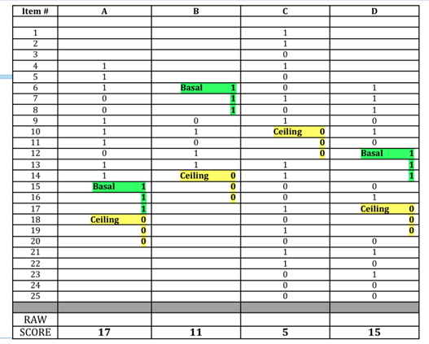
Did you get the correct raw score?

Slide 37
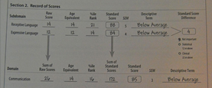


Raw Score – WHAT's NEXT?
Step 1: Record raw scores on the front of the scoring sheet for each domain. You determine the child’s Standard Scores on the DAYC-2 in relation to his or her chronological age. Be careful you are on the right column.
Step 2: Convert your Raw Scores to into age equivalents. Go to Appendix A (pg. 60). Look under the Domain tested and go to the Raw Score listed in that column. Look to the left column to see the Age equivalent to the score received.
Let's do an example: Pg 14 & 17.
Sum of Raw Scores
Sum of Standard Scores

Slide 38

Calculating Raw Score To Standard Scores - Appendix B in the Examiner’s Manual on Page 63.
Step 1: (Q) How old is Marco? (A) 13 months (Q) What page in Appendix B? (A) Pg 80
Step 2: Converting Raw Scores to Standard Scores – Once on the correct page (Age in Months across the top of the table), you must make sure you are on the correct column depending on the domain.
Step 3: Find the raw score in the outer columns to the right and to the left of the chart. Where those intersect on the chart is the Standard Score for the domain.

Slide 39

Converting Standard Score to Percentile Ranks - Appendix C in the Examiner’s Manual on Page 117.
(Q) Marco's Standard Score was 87. What was his Percentile Rank? (A) 19%
This chart is the same for everyone and is all on one page and is the same chart for all domains.
The DAYC provides standard scores with a mean of 100. The Percentile Rank describes how the child is doing when compared to other children at this age.

Slide 40


Only descriptive label for English New Language Learners
People sometimes confuse a language deficiency with a learning disability.
According to the Test Resource Guide Vol. 1 (1991 ed.) p.4 “test scores should not be reported for limited English proficiency children and other students for whom the norm are unrepresentative. In those cases, only descriptive information about student performance on the tasks included on the test may be included.” Any data presented, such as raw score on test/subtest, will be used for qualitative and comparative purposes only. This is a bilingual evaluation; therefore, results are presented in a descriptive, qualitative manner and should be considered estimates of ability, due to the absence of appropriate local norms. Formal testing procedures were modified and translated to accommodate bilingual issues. Results from the testing of bilingual-bicultural students must be interpreted with caution because standardized procedures and appropriate norms are not available to represent this population.
This paragraph is added to the report for bilingual children.

Slide 41
One More Appendix to GO!! Converting Sums of subdomain standard scores to domain standard scores
Go to Page 121 of the Examiner’s Manual. This Appendix is used for the Communication and Motor Development domains.
Go to our example on Pg 17. Marco received a Standard score of 88 on Receptive Language and a Standard score of 84 on Expressive Language.
  (Q) What is the sum of the Standard Scores? (A) 172.
  (Q) Looking at the chart, (pg 121) what is the Domain Standard Score? (A) 85. Use the same chart to figure out the descriptive label.

Slide 42
Report writing
Reporting the DAYC-2 results accurately

Slide 43

TYPES OF Report
Annual Reports – written yearly to measure student's growth. Handed in 60 days before the expiration of the IEP date. Full report with IEP, includes 12 Month Regression Form if you are asking for summer services.
Turning 5 Report – written for children going to Kindergarten. (Ex: 2017 -birth year is going to Kindergarten, Fall 2022; 2018 -birth year is going to Kindergarten, Fall 2023)
Requested Review – this can happen any time after the 3-month implementation of a new IEP. This request may/may not require a full report. This is determined by the recent documents submitted for the child and the type of requested change.

Slide 44
PARTS of a report Part 1:
Opening and Separate Domains Described
Opening Section contains the child's information: Name, DOB, OSIS#, etc..
Background Information stated the setting and approved services the child is receiving.
Behavioral Teacher Observations shares your general impressions of the child. Some ideas:
  Required additional prompting, required adult assistance, need of verbal and visual cues, sensory issues, problems with transition, performed better in one setting over the other (group vs. individual), degree of attention span and distractibility, need to differentiate, level of play skills, overall demeanor.
Each Domain from the DAYC-2. Begin each section with a general summary statement such as this, "Based on parent report, observation and informed clinical opinion, supported by portions of the DAYC-2, XXX is functioning in the XXX range in this area." This is followed up with a paragraph of what the child can do with the next paragraph stating what the child cannot do. This information is taken directly from the testing material.

Slide 45
PARTS of a report Part 2:
Summary and Program Recommendations
Add this chart which summarizes your finds and in these 2-3 paragraphs tell the story of why the child needs services.
Stress the key points. Some people like to add 1-2 sentence per domain.
Highlight key observations such as behaviors that affect academic performance to be considered for placement, such as tantrums and excessive crying; sensory & transition issues and ASD diagnosis as some examples.
Developmental Area | Raw Score | Standard Score | Percentile Rank | Descriptive Term
Cognitive | 54 | 86 | 18% | below average
Receptive Language | 26 | 77 | 6% | poor
Expressive Language | 35 | 102 | 55% | average
Total Language | 61 | 89 | 23% | below average
Social Emotional | 63 | 120 | 91% | above average
Adaptive | 44 | 89 | 23% | below average
Gross Motor | 48 | 102 | 55% | average
Fine Motor | 25 | 89 | 23% | below average
Total Motor | 73 | 95 | 37% | average

Slide 46
PARTS of a report Part 2:
Summary and Program Recommendations
EXAMPLES
EXAMPLES
General Summary of Student performance
According to the DAYC 2, XXX has poor cognitive skills with a 60% delay. XXX has poor receptive language skills with a 42% delay. XXX has below average expressive language skills with a 27% delay. XXX has average social-emotional skills. XXX has below average cognitive skills with a 45% delay. He has average fine motor skills. XXX has poor adaptive skills with a 42% delay.
Mini Summary per Domain
COGNTIVE: XXX attempts to start toy if he or she has seen some else make it work. He places a small object in small containers (raisin into a small bottle). He imitates scribbling. XXX demonstrates appropriate use of everyday items (pretend drinking from a cup). He combines two relates objects during play (bowl and spoon, brush to doll’s hair).
RECEPTIVE LANGAUGE: He points to five or more familiar persons, animals, or toys. He indicates yes or no with a head shake or with words. He follows directions about placing one item in and on another. Parent stated that XXX points to more than 6 body parts. He does not carry out two-step directions.
EXPRESSIVE LANGAUGE: He has about 20 words in his vocabulary, but he does not use them all functionally and daily. He says 2-3-word phrases occasionally independently. He may repeat the phrase stated by an adult. He does not use contractions when he speaks. XXX does not use facial expressions and body language to demonstrate at least 5 emotions.

Slide 47
PARTS of a report Part 2:
Summary and Program Recommendations
EXAMPLES
EXAMPLES
Mini Summary per Domain
SOCIAL-EMOTIONAL: He has limited eye contact. He sometimes remains calm when small requests denied. XXX changes to a new activity when he wants to do so. If he is redirected, he cries to go back to his old activity. XXX does not volunteer to help with household chores.
GROSS MOTOR: When XXX threw a ball, he threw it up. He did not throw it near the intended receiver. XXX does not catch a ball thrown to him. He kicks a ball in a stationary and a moving position. XXX squats during play. Parent stated that XXX often falls when he is running.
FINE MOTOR: XXX scribbles when given a writing utensil. He holds it with a fist and with a tripod hold. XXX enjoys playing with puzzles and completes most simple puzzles. He has difficulty stacking blocks. Parent stated that he often prefers to line them up.
ADAPTIVE: He recognizes his home when they are nearby. XXX does not cover his mouth when he coughs or sneezes even with a verbal prompt. He may say please and thank you during the day. XXX is not toilet trained. He wears diapers, but he is starting to indicate when he must use the bathroom. XXX does not request privacy in the bathroom.

Slide 48
PARTS of a report Part 3:
Standard ENDING for every report
Final recommendations for services XXX will be made at CPSE meeting in consultation with the parents to determine eligibility. The results of the assessment were fully shared and discussed with the parent at the completion of the evaluation process. The evaluator shared clinical findings and answered the parent’s concern regarding the evaluation.
I, hereby certify that I personally evaluated the above-named child, employed age-appropriate instruments and procedures as well as informed clinical opinion. I further certify that the findings in this report are an accurate representation of the child’s level of functioning at the time of my assessment.
Your Full Name, Degree (ex:MSEd b-2)
SEIT Teacher
NYS Special Educational Teacher
Certified in Special Education/Early Childhood Education Birth to Grade 2

Slide 49
CREATING THE SMART IEP
The TOOL NEEDED TO HELP THE CHILD MOVE FORWARD

Slide 50

IEP: PURPOSE AND REQUIRED COMPONENTS
Individuals with Disabilities Education Act - 2004 (IDEA) requires a student’s IEP to include a description of the student’s progress toward his/hers annual goals, the method(s) used for measuring the students progress, and when parents can expect to receive periodic progress reports outlining their student’s goals and progress thus far.

Slide 51


IEP: PURPOSE AND REQUIRED COMPONENTS
The IEP puts the stress on individualized. An IEP is written specifically for the child’s needs.

Slide 52

What makes up a good IEP?
What makes up a good goal for an IEP:
Be specific and focus on one skill at a time
Be measurable to monitor progress
Use action words to describe how to address the skill Be realistic by keeping the child’s abilities in mind
Be time limited and attainable within the school year
What to expect with setting goals:
Number of goals depends on each child
Determine which team member is responsible for helping your child meet those goals. (Teacher vs. Therapist)

Slide 53




ALWAYS remember the reason you became a teacher!

